Slide 1



Multimedia & Graphics
Class VI
lab 13

Slide 2
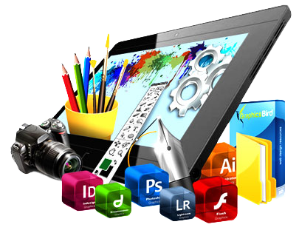
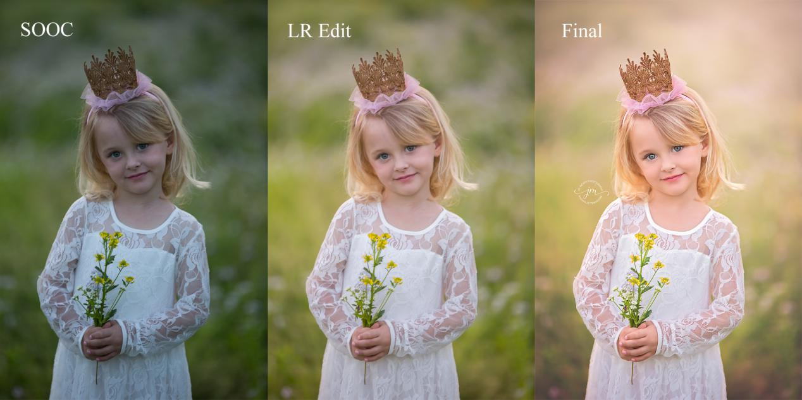
Photo Editing
the act of altering
an image

Slide 3
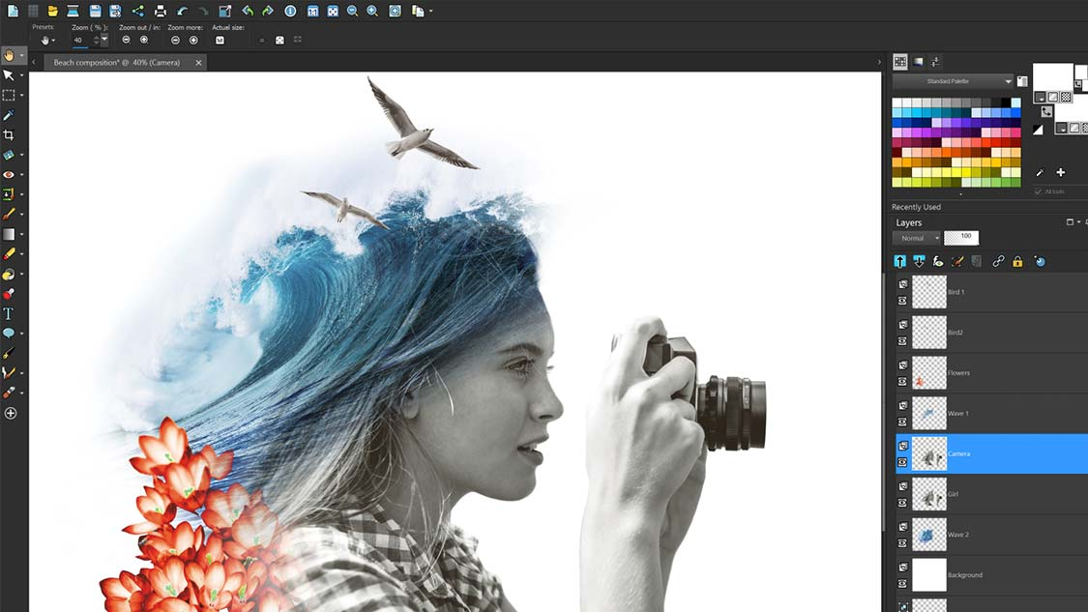
Photo Editing Techniques
Noise reduction
White balance
Contrast
Lens correction
Exposure
Color adjustments
Resizing and cropping
Background removal

Slide 4
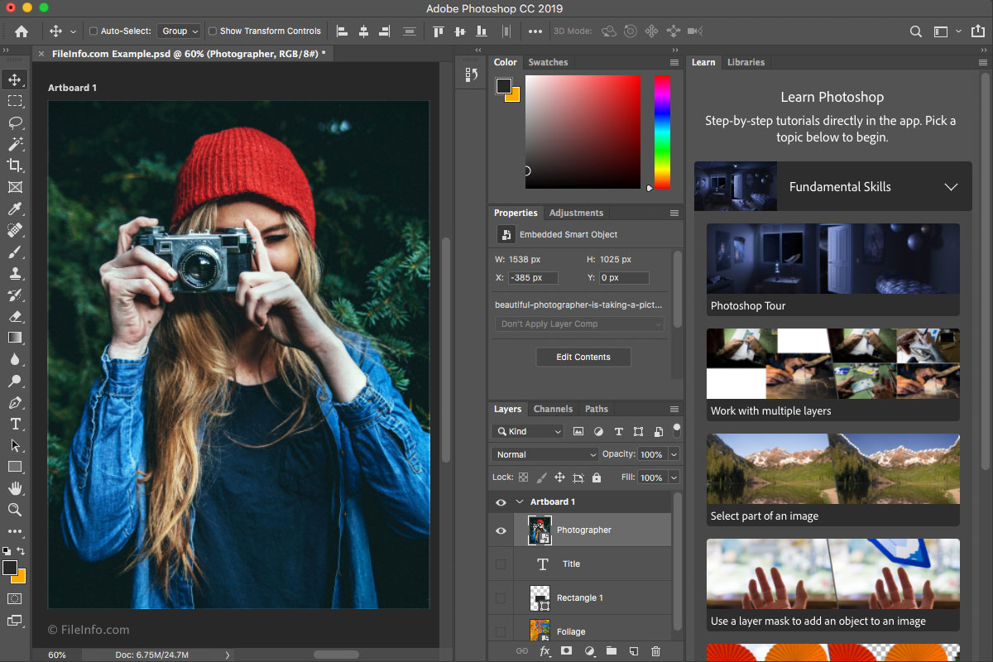
Photo Editing Software
The tools which you
can use to edit or manipulate images

Slide 5
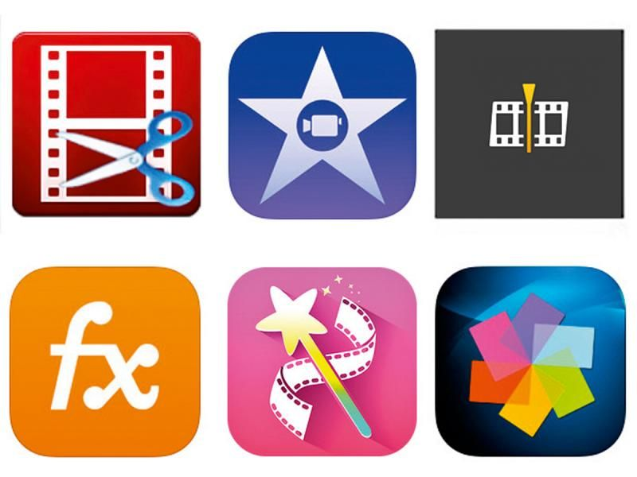
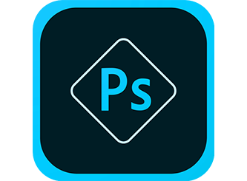
Popular Photo Editing Software
1) Adobe Photoshop 2) Serif Affinity Photo 3) Pixlr 4) Aviary 5) Canva 6) GIMP 7) Microsoft Paint 8) Sketchpad

Slide 6
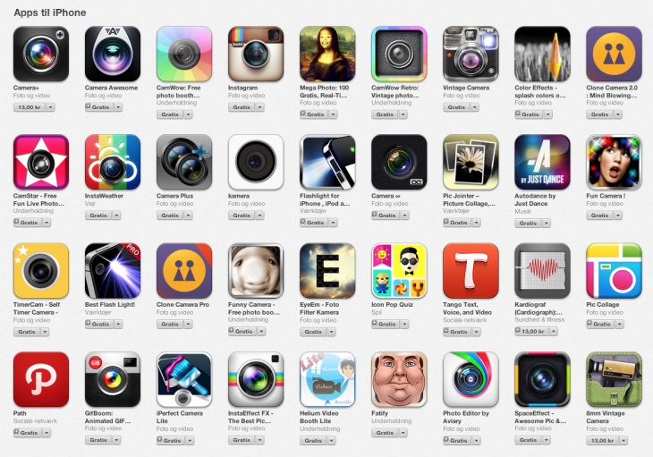
Popular Photo Editing Mobile Apps
Snapseed VSCO Afterlight Instagram Enlight Photofox

Slide 7



